Slide 1

TOPIC: PERSONALITY Part I
(Definition, Dimensions, Topography, Classification)
BY
Ms. Saroj BALA
(Faculty, RUHS CONS)
RUHS COLLEGE OF NURSING SCIENCES, Jaipur
WELCOME
Subject: Psychology for Nurses
BSc Nursing Part I

Slide 2
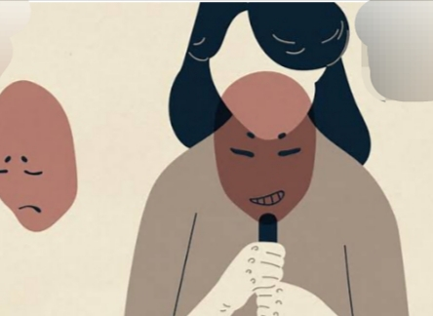
INTRODUCTION
The word Personality has been derived from the Latin word ‘Persona’.
At first this word was used for the ‘mask’ that was worn by the actors (Roman and Greek) in ancient times.
Personality is the total quality of an individual that is shown in his/her behavior and these qualities are- thinking, attitudes, interests, the pattern of behavior, habits, the personal philosophy of life.
Persona
(Latin word)
means
Mask
(worn by actors)
By Ms. Saroj Bala
(Faculty, RUHS CONS)

Slide 3
DEFINITIONS
According to Allport, ‘Personality is the dynamic organization within the individual of those psychophysical systems that determine the unique adjustments in his environment.’
According to APA (American Psychiatric Association), 1987, ‘Personality refers to deeply ingrained patterns of behavior which include the way one relates to, perceives and thinks about the environment and oneself.’
According to Bigge and Hunt, ‘Personality refers to the whole behavioral pattern of an individual to the totality of its characteristics.’
According to N.L. Munn, ‘Personality may be defines as the most characteristic integration of an individual’s structure, modes of behavior, interests, attitudes, capacities, abilities and aptitudes.’
By Ms. Saroj Bala
(Faculty, RUHS CONS)

Slide 4

DIMENSIONS
Self consciousness
Sociability
Strong will power
Developmental continuity
Physical and mental health
Adjustability
Goal directedness
Unity and integration
By Ms. Saroj Bala
(Faculty, RUHS CONS)

Slide 5
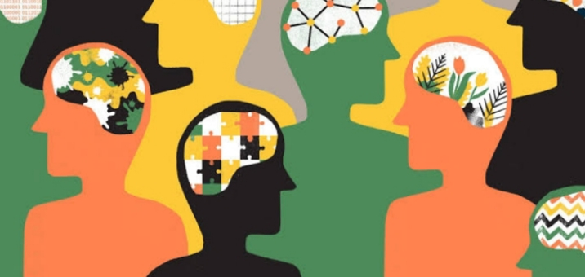
TOPOGRAPHY
It is a product if heredity and environment.
It is affected by social and cultural factors.
It includes the cognitive, affective and psychomotor behaviors and it covers:
Conscious
Sub conscious
Unconscious
It is specific and unique for each and every individual
It is dynamic in nature
It keeps an individual adjusting in his environment.
It is sum of physical, mental and social qualities in an integrated manner.
It refers to persistence of qualities
It is the dynamic orientation of the person to his environment and
It is influenced by social interactions
It is integration of many qualities like psychological, social, cultural and physiological.
By Ms. Saroj Bala
(Faculty, RUHS CONS)

Slide 6
CLASSIFICATION
Classification of personality has been done in various ways. Some of them are as follows:
Classification of Personality
According to Type Theory
Ancient Classification
Modern Classification
According to Trait Theory
According to Allport
According to Cattell
By Ms. Saroj Bala
(Faculty, RUHS CONS)

Slide 7
According to Type Theory
According to Type Theory
Ancient Classification
According to Hippocrates
According to Bhagvad Gita
Modern Classification
On the basis of physical characteristics
According to Ayurveda
On the basis of psychological characteristics
By Ms. Saroj Bala
(Faculty, RUHS CONS)

Slide 8
Ancient Classifications
According to Hippocrates
Types of Body Fluids | Types of Personality | Characteristics
1. Blood | Sanguine | Optimistic, Happy, Hopeful, Accommodating and light hearted
2. Phlegm | Phlegmatic | Cold, Calm, Slow, Indifferent
3. Black Bile | Melancholic | Sad, Depressed, Pessimistic, Dejected, Deplorable, and Self involved
4. Yellow Bile | Choleric | Irritable, Passionate, Strong, Active, Imaginative
By Ms. Saroj Bala
(Faculty, RUHS CONS)

Slide 9
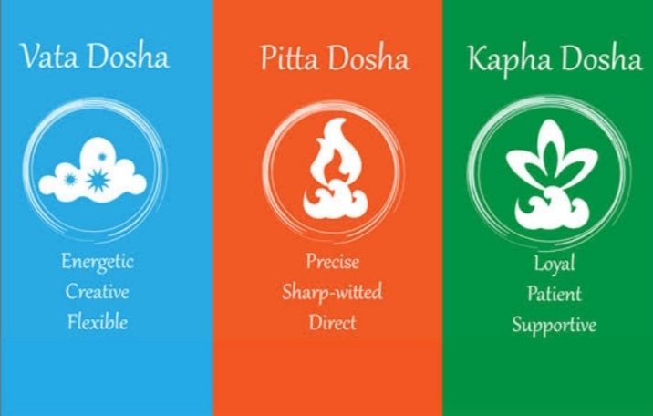
According to Bhagvad Gita, Personality is defined as ‘Gunas’ and they are 3 in number:
Satvas
Rajas
Thamas
According to Ayurveda, the classification is done into 3:
Vata
Pitta
Kapha
By Ms. Saroj Bala
(Faculty, RUHS CONS)

Slide 10
Modern Classification
Modern Classification
On the basis of physical characteristics
According to Kretschmer
According to Sheldon
On the basis of psychological characteristics
According to Karl Jung
According to Eyesenck
By Ms. Saroj Bala
(Faculty, RUHS CONS)

Slide 11
According to Kretschmer (German Psychologist)
**On the basis of study, the patients have been identified with ‘schizophrenia’ and “manic depression’.
Type of Personality | Characteristics
Pyknic Type (Person who have fatty bodies) | Sociable, Jolly, Easy going, Good natured These person may have characteristics of ‘Manic Depression’ They have ‘cycloid’ temperament
2. Asthenic Type | Not too long or not too short in height Weight is not according to height and age Irritable nature They keep distance from the society and social responsibilities They live in fantasy They are prone to have symptoms of schizophrenia Their temperament is known as ‘schizoid’
3. Athletic Type | Balanced body structure Adequate muscle growth Social prestige They can do adjustment according to the situation
4. Dysplastic Type | They don’t have particular qualities of above 3 types of personality but they have mix characteristics of these personalities
By Ms. Saroj Bala
(Faculty, RUHS CONS)

Slide 12
Sheldon’s Classification
His theory is known as ‘somato type theory’
He did a study on 4000 students and classified the personality into 3 types
Type of Personality | Structure of Personality | Symptoms/Characteristics
1. Endomorphic | The person who has endomorphic personality has highly developed viscera Their somatic structure is same as pyknic type personality (fat, round body) | Easy going Sociable Fond of eating, sleeping and drinking Good nature Jolly nature Their temperament is known as ‘viscerotonia’
2. Mesomorphic | Balanced development of viscera Strong physical structure Muscles are well developed in the person having this type of personality They seem like ‘athletic’ type of personality | Balanced body structure Adequate muscle growth Social prestige They can do adjustments according to the situations Craving for muscular activity Energetic Have confidence to take risk Love to do adventurous activity Bold temperament Their temperament is known as ‘somatotonia’
By Ms. Saroj Bala (Faculty, RUHS CONS)

Slide 13
Type of Personality | Structure of Personality | Symptoms/ Characteristics
3. Ectomorphic | Weak physical structure Under-developed viscera like thin, long, fragile They seem like ‘asthenic’ type of personality | Not too long or not too short in height Irritable nature Unsociable Reserved nature Pessimistic Introvert Their temperament is known as ‘cerebrotonia’
By Ms. Saroj Bala
(Faculty, RUHS CONS)

Slide 14
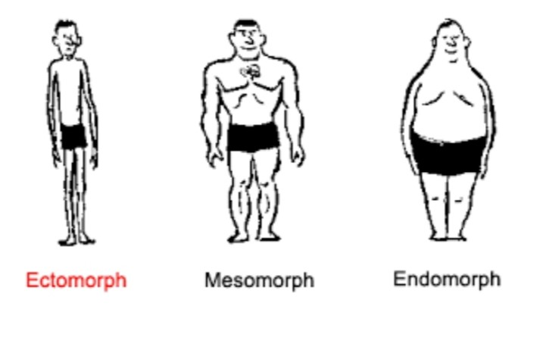

Slide 15
Classification of Karl Jung
**Ambiverts: The term ‘ambivert’ was given by one of the followers of Karl Jung. They have characteristics of both introvert and extrovert personality.
Extrovert | Introvert
They have interested in external environment Sociable and friendly They don’t become upset due to difficulties They can do adjustment in the real environment They are socially active and they want to leave impression on the public Their behavior is affected by physical factors rather then thoughts and ideas Eg: Politicians, lawyers, salesman, insurance agent, social workers, journalists | They are interested in their own world Unsociable They easily become upset due to difficulties They cant adjust in the real environment They avoid social contact and they like to work alone Their behavior is affected by self activities and thoughts and ideas rather than physical factors Eg: Scientists, philosophers, writers
By Ms. Saroj Bala
(Faculty, RUHS CONS)

Slide 16
According to Eyesenck
Eyesenck studied about 10,000 normal person and patient with neural diseases and he planned special statistical analysis and he classified the personality into 3 types.
All 3 types are bipolar:
Extroversion v/s Introversion
Neuroticism v/s Stability
Psychoticism v/s Super Ego Function
Extroversion v/s Introversion
He appreciated the classification of personality which was given by ‘Karl Jung’ but he did not accept introvert and extrovert as separate types of personality
He said that these are opposite to each other but can be studied on a pattern scale, so he included them in one type of personality i.e. ‘BIPOLAR’
Bipolar
One pole is extroversion
Second pole is introversion
By Ms. Saroj Bala
(Faculty, RUHS CONS)

Slide 17
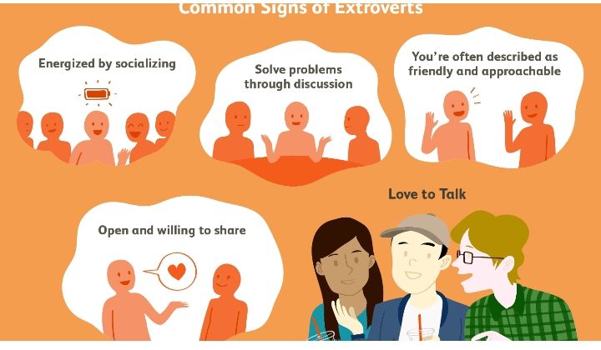
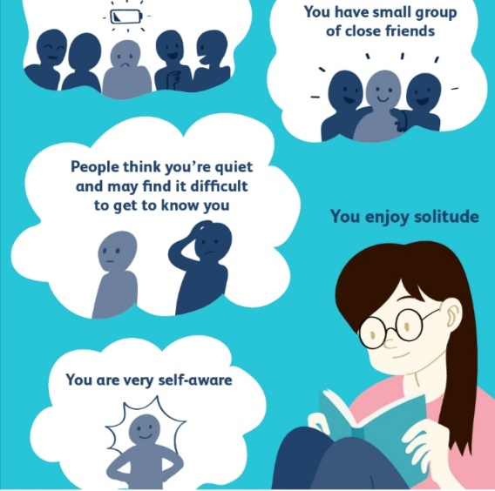
Extroversion
-Optimistic
-Active
-Outgoing
-Talkative
-More interested in external world
Introversion
-More interested I inner world
-Reserved nature
-Quiet
-Less talkative
-Unsociable
-less active
-pessimistic
By Ms. Saroj Bala
(Faculty, RUHS CONS)

Slide 18
2) Neuroticism v/s Emotional Stability
Emotional Stability
-Balanced emotional activity
-Absence of rapid mood change
-Reliable
-Calm
-Leadership Quality
Neuroticism
-Anxious
-Moody
-Touchy
-Restless
-Slow thought process
-Slow activity
-Less emotional control
-Aggressive
By Ms. Saroj Bala
(Faculty, RUHS CONS)

Slide 19
3) Psychoticism v/s Super Ego Function
Super Ego Function
-They have control on their behavior
-Thoughtful
-Calm
-They can control their impulses
Psychoticism
-Aggression
-Aloofness
-Anti social behavior
- Susceptibility to Psychosis
By Ms. Saroj Bala
(Faculty, RUHS CONS)

Slide 20
Common Traits:
-Common traits are shared by several people within a given culture
Individual Traits:
-These traits are also called natural traits.
-They guide, direct and motivate the individual to adjust in the environment.
-They reflect the uniqueness of the personality of a person.
-Allport gave main focus on the study of these personal traits.
-He called them ‘personal dispositions’.
-He classified them into 3 types:
Cardinal Traits
Central Traits
Secondary Traits
By Ms. Saroj Bala
(Faculty, RUHS CONS)

Slide 21
Trait Theory
In Psychology, ‘Trait Theory’ is an approach to study the human personality.
It is also called ‘Dispositional Theory’
Trait is defined as habitual patterns of behavior, thoughts, emotions.
Trait is a quality that forms characteristics/ personality.
Traits are aspects of personality which are different in different individuals, they may change according to time/ over the time
Acc. To Trait Theory, personality is made up of different traits. This theory says that personality cannot be controlled but it can be classified on the basis of several basis
Ex: Honesty, Loyalty, Responsibility, Cooperativeness, Punctuality, Faithfulness, Truthful
By Ms. Saroj Bala
(Faculty, RUHS CONS)

Slide 22
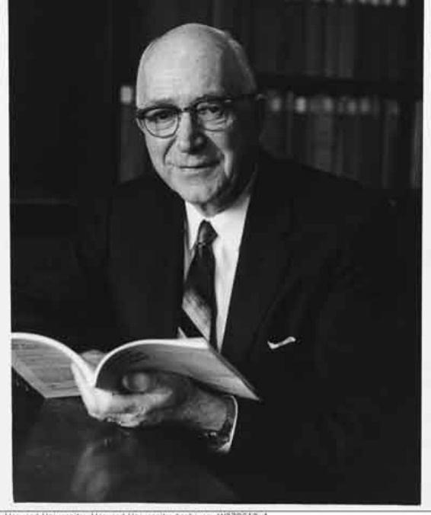
Allport’s Classification
He classified the traits into 2 types:
Common traits
Individual traits
Allport’s Classification of Traits
Common Traits
Individual Traits
Cardinal Traits
Central Traits
Secondary Traits
By Ms. Saroj Bala
(Faculty, RUHS CONS)

Slide 23
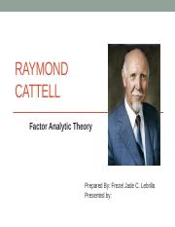
Cattell’s Classification
He classified the traits into 2 types:
Surface traits
Source traits
Cattel’s Classification of Traits
Surface Traits
Source Traits
By Ms. Saroj Bala
(Faculty, RUHS CONS)

Slide 24
SURFACE TRAITS:
-These traits can be seen in the daily activities of a person.
For eg: Helping nature, happiness etc.
SOURCE TRAITS:
-They make inner structure of one’s personality.
-They can be known by merging various respective traits and a new source trait can be seen.
-He said that there are 23 source traits which can be found in normal people and there are 12 source traits which can be found in abnormal people.
-He said that 16 source traits are more important among these 23 source traits.
-He prepared a questionnaire to measure these 16 source traits. This questionnaire is known as ’16 PF Questionnaire’ (PF= Personal Factors)
By Ms. Saroj Bala
(Faculty, RUHS CONS)

Slide 25
CARDINAL TRAITS: Cardinal trait is very dominant in the behavior of a person. It can be seen in all the actions done by a person. Very few people have these cardinal traits.
Eg: Non violence trait was dominant in the nature of Mahatma Gandhi or dictatorship in the nature of Hitler or Napolean Bonaparte.
CENTRAL TRAITS: These traits reflect the personality less than the cardinal traits. These are not as dominant as cardinal traits. They are called building block of the personality.
Eg: Honesty, Loyalty, Punctuality, Confidence, Responsibility, Skilled behavior
SECONDARY TRAITS: These are the least generalized characteristics of a person. These are not consistent traits in one’s personality. These are less relevant in reflecting the personality of a person.
Eg: Food choices, Clothing Choices
By Ms. Saroj Bala
(Faculty, RUHS CONS)

Slide 26

THANK You
Ms. Saroj Bala (Faculty, RUHS CONS)
Digital Assistance By:
Arsha Nair (Student, BSc Nursing Part II, RUHS CONS)
Lovely Sharma (Student, BSc Nursing Part I, RUHS CONS)

