Slide 1

TOPIC: PERSONALITY PART II
(Theories of personality and Personality test)
BY
Ms. Saroj BALA
(Faculty, RUHS CONS)
RUHS COLLEGE OF NURSING SCIENCES, Jaipur
WELCOME
Subject: Psychology for Nurses
BSc Nursing Part I

Slide 2
THEORIES OF PERSONALITY
Theories of Personality
Dynamic Theory
Psychoanalytical Theory
Psychoanalytic Interpersonal Theory
Humanistic Theory
Early Social Learning Theory
Type and Trait Theory
Learning and Behavioral Theories
Psychosocial Theory
Analytical Theory
Individual Theory
Skinner’s Theory
Later Social Learning Theory
Self Theory
Self Actualisation Theory
Type Theory
Trait Theory
**Some of the theories are discussed here. Rest of them will be discussed in the next ppt.
By Ms. Saroj Bala
(Faculty, RUHS CONS)

Slide 3
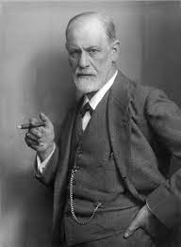
PSYCHOANALYTICAL THEORY
These theory was given by SIGMUND FREUD.
Two models were given by Sigmund Freud to understand the structure of personality.
Structural model
Dynamic model
By Ms. Saroj Bala
(Faculty, RUHS CONS)

Slide 4
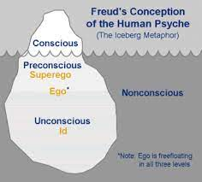
1. Structural model
It has been divided into 3 parts
Conscious
Sub/Pre Conscious
Unconscious
The individual functions of 3 level of awareness
-Conscious level
-sub/preconscious level
-unconscious level
By Ms. Saroj Bala
(Faculty, RUHS CONS)

Slide 5
1.Conscious level
It consist of current thoughts ,experience , ideas ,thinking etc..
It makes the individual immediately aware of surroundings at any particular time .
For example-observing somebody
-judging somebody
-reasoning
-understanding something
Every conscious experiences has 3 aspect.
-Cognitive –knowing
-Affective – feeling
-Conative –striving [acting]
By Ms. Saroj Bala
(Faculty, RUHS CONS)

Slide 6
2..Sub/Pre conscious level
Pre conscious thoughts are memories of which an individual may not be aware of but can recall to mind when he wishes
This level is also known as subconscious level
Ex- sometime we forget name of any person during communication but we can recall it by making efforts .
It is possible to recall the name when it is at pre conscious level.
By Ms. Saroj Bala
(Faculty, RUHS CONS)

Slide 7
3. Unconscious level
The third level of consciousness is ‘’unconscious’’.
It includes all the mental activities which a people or individual is not aware of.
According to Freud the unconscious is a reservoir of animal derives[desires].
It also stores all the ideas and wishes that are comes from conscious awareness.
Most of these ideas and wishes arise from sexual desires which can not be expressed openly that’s ‘why an individual try to repress them.
People try to fulfill these ideas in socially acceptable manner or try to repress them in unconscious level of mind.
Unsuccessful ideas and unfulfilled wishes result in abnormal feelings.
Our conscious behavior sometimes reflects our unconscious feelings.
These unconscious process can be brought to conscious by using special methods of psychoanalysis.
Freud believed that the greater part of our conscious behavior is controlled by our unconscious level of awareness.
Dr Freud and his followers told that the unconscious level includes all the forgotten experiences, repressed ideas and wishes, fears, phobia, repressed, likes and dislikes.
The unconscious level is the greater part of level of consciousness. It means it is the greatest part of mind.
By Ms. Saroj Bala
(Faculty, RUHS CONS)

Slide 8
2.Dynamic model
According to Sigmund Freud theory the primary structural elements of personality are:
Id
Ego
Super Ego
These are concepts ,not real physical structure. Freud believed that psychic energy is the force for mental functioning and he said that the personality of human being can be understand by studying these 3 major hypothetical structures.
By Ms. Saroj Bala
(Faculty, RUHS CONS)

Slide 9


Slide 10
1) Id
Id represents the most primitive [primary]structure of the human personality.
It contains [includes] all our biological based derives [desires].
It is the source of innate [inner, internal, instinctual]energy.
It deals with immediate satisfaction of primitive needs ,sexual desires and aggressive impulses.
Id works on the pleasure principle ,it means that people want pleasure and try to avoid pain.
Id does not care of for moral values, society and other individual.
Id is impulsive ,pleasure oriented, disconnected from reality and may be irrational.
It is derived by two instinctual energies –
-life instinct to satisfy desires -Death instinct [self destruction]
By Ms. Saroj Bala
(Faculty, RUHS CONS)

Slide 11
2) Ego
It represents the part of the human personality which is in closest contact with reality.
The ego functions on the basis ‘Reality principle’.
It maintains relation between the external world , the Id and the superego.
Ego is capable of postponing pleasure until and appropriate time, place and object is available.
Ego is not driven to blind conformity with rules and regulations.
Ego acts as mediator between the Id and the superego.
It grows out of id. It seeks to satisfy the inner energy of an individual according to reality
The ego is patient and reasonable.
For example :
The id of a boy wants an ice cream cone and tells him to grab the cone and eat it. His ego tells him that if he grabs the cone without permission, he will be punished.
So working on the reality principle the boy knows that the best way to achieve satisfaction is to ask for permission to eat the cone. While the id was demanding, unrealistic and worked according to pleasure principle but the ego was patient and worked on reality principle.
Ego deals with anxiety and Freud believed that people avoid anxiety by developing defense mechanism that try to defend the ego against the instinctual needs. These defense mechanisms are also known as ‘’mental mechanism’’.
By Ms. Saroj Bala
(Faculty, RUHS CONS)

Slide 12

These are some defense mechanism:
Repression
Projection
Denial
Reaction mechanism
Displacement
Rationalization
Sublimation
Compensation
Regression
Dissociation
Conversion
Dissociation
Conversion
Suppression
Substitution
Isolation
By Ms. Saroj Bala
(Faculty, RUHS CONS)

Slide 13
3) Superego:
It represents the part of personality which is important to characterize / to know the moral branch of mental functioning .
It works on ‘moral principle /perfection principle.
It works just opposite to the id.
It helps in the socialization of the individual because it helps the ego in the control of id impulses.
It means it helps to control the id by internalizing the parental authority through the process of socialization
For example;
If a boy wants an ice cream cone and he asks to his mother, his superego will indicate that his behaviour is morally correct.
A person who is mentally healthy [well adjusted] has all the 3 components of the personality.
Freud used free association, dream analysis, analysis of errors, to understand functioning of mind.
By Ms. Saroj Bala
(Faculty, RUHS CONS)

Slide 14
Freud’s Structure of Personality
ID
Pleasure Principle
(Needs, Wishes)
EGO
Reality Principle
(Critical Mind)
SUPER EGO
Moral/ Perfection Principle
(Rules and Regulations
By Ms. Saroj Bala
(Faculty, RUHS CONS)

Slide 15
FIVE STAGE THEORY
Stages of personality development by Freud
Psychosexual development of personality
Freud proposed a ‘’Five stage theory’’ of personality to describe formation of personality.
These stages are;
Oral stage
Anal phage
Phallic stage
Latency stag
Genital stage
By Ms. Saroj Bala
(Faculty, RUHS CONS)

Slide 16
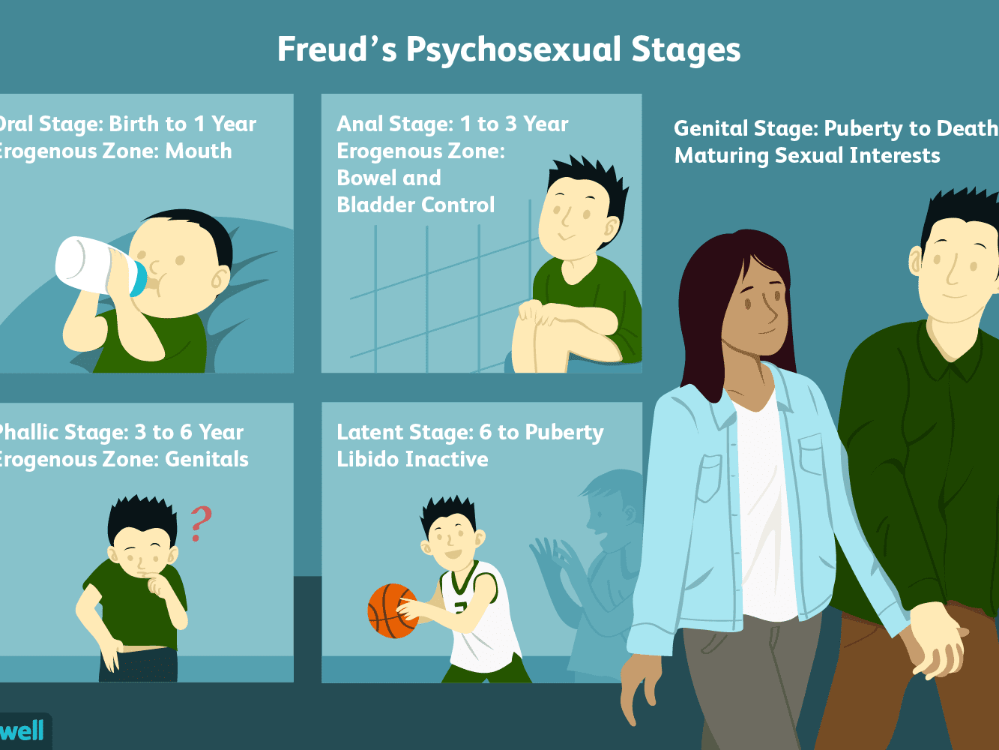

Slide 17
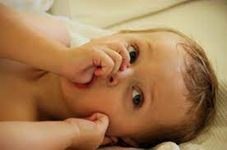
1.Oral stage
Duration; Birth to 21 years of age
Characteristics; use mouth and tounge to deal with anxiety.
For ex; sucking , feeding
It is first stages of psychosexual development of personality .
Successful task completion: oral gratification.
Unsuccessful task completion;
-Smoking
-Alcoholism
-Nail biting
newborn instincts are focused on the mouth.
This is the infants primary pleasure seeking behavior.
The infants achieves oral gratification through feeding, thumbsucking, biting.
If an infants faces difficulty during this stage ,he will consider the world as a bitter in his later age
By Ms. Saroj Bala
(Faculty, RUHS CONS)

Slide 18
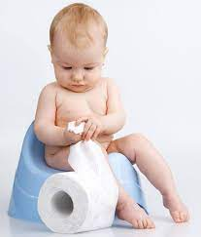
2.Anal stage
Duration; from 1 year to 3 year age of life.
Characteristics:
-Muscle control in bladder , rectum, anus provides sensual pleasure.
-Toilet training can be a crisis.
-He feels pleasure during defecation, urination.
-The center of pleasure now becomes anus and bladder rather than mouth
-This is the second stage of psychosexual development.
Successful task completion: Bowel and bladder control
Unsuccessful task completion: constipation, perfectionism
By Ms. Saroj Bala
(Faculty, RUHS CONS)

Slide 19

3.Phallic stage
Duration: 3 to 7 years
Characteristics: learn sexual identification and awareness of genital area as a center of pleasure.
The development of Electra complex and Oedipus complex occurs during this stage of development .
Freud described this stage as the child unconscious desire to eliminate the parent of the same sex and to like the parent of the opposite sex.
Successful task completion: Child becomes aware of sexuality
Unsuccessful task completion: homosexuality, sexual identify problems in general, difficulty in accepting authority
By Ms. Saroj Bala
(Faculty, RUHS CONS)

Slide 20
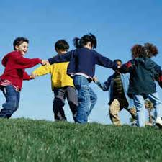
4.Latency stage
Duration: from 7years of age until puberty
Characteristics:
-Fourth stage
-Quite stage in sexual development
-The child continuous to grow physically but sexual desires are relatively inactive.
-Child energy is channelled into social activities.
Successful task completion: child learns to socialized
Unsuccessful task completion: inability to conceptualize, lack of motivation in society or job
By Ms. Saroj Bala
(Faculty, RUHS CONS)

Slide 21

5.Genital stage
Duration: from puberty to adulthood.
Characteristics:
-fifth stage
-sexual maturity
-fears and repressed feelings of earlier stages are ones again exhibited.
-Satisfactory relationship with the opposite size.
Successful task completion: sexual maturity
Unsuccessful task completion: frigidity [coolness], premature ejaculation, unsatisfactory relationship.
By Ms. Saroj Bala
(Faculty, RUHS CONS)

Slide 22
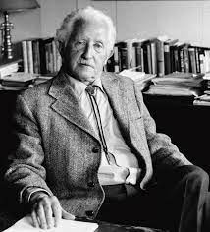
PSYCHOSOCIAL THEORY
This theory was given by ‘’Erik Erikson’’[1902-1994] who was a German psychologist [psychoanalyst].
He extended Freud work on personality development during the life span.
But he focused on social and psychological development in the life stages.
According to Erikson , psychological growth occurs in different sequential phases and each stage is dependent on the completion of previous stage and task of that stage .
He told 8 stages of personality development and all the stages are developed through a procedure [rule]that is known as Epigenetic rule.
During these phases personality is developed by the interaction of ‘’biological and social factor’’.
According to Erikson the personality of human being is developed through many predecided phases and these phases are universal.
By Ms. Saroj Bala
(Faculty, RUHS CONS)

Slide 23
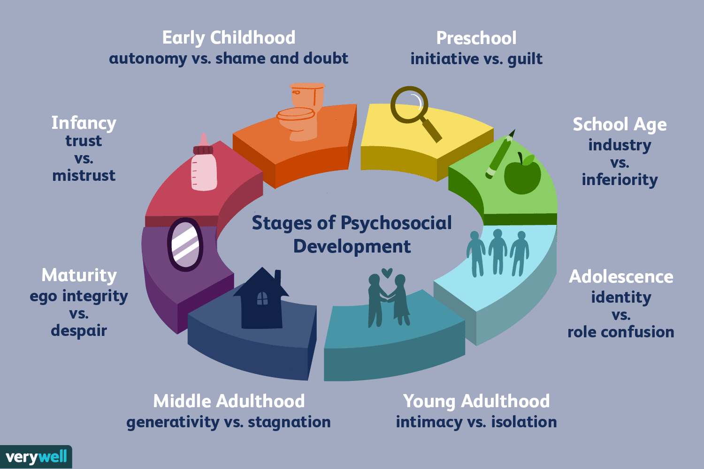
By Ms. Saroj Bala
(Faculty, RUHS CONS)

Slide 24
The 8 stages of personality development are given below:
Stage [infant] - Trust v/s mistrust
Stage [Toddler] - Autonomy v/s shame and doubt
Stage [Preschool] - Initiative v/s guilty
Stage [School ] - Industry v/s inferiority
Stage [Adolescence] - Identify v/s role confusion
Stage [young adult] - Intimacy v/s Isolation
Stage [middle adult ] - Generativity v/s stagnation
Stage [maturity] - Ego integrity v/s despair
By Ms. Saroj Bala
(Faculty, RUHS CONS)

Slide 25
Psychosocial Development
1. INFANT
(Trust vs Mistrust)
2. TODDLER
(Autonomy v/s Shame)
3. PRESCHOOLER
(Initiative v/s Guilt)
4. SCHOOL AGE
(Industry v/s Inferiority)
5. ADOLESCENCE
(Identity v/s Confusion)
6. YOUNG ADULT
(Intimacy v/s Isolation)
7. MIDDLE ADULT
(Generativity v/s Stagnation)
8. MATURITY
(Ego Integrity v/s Despair)
By Ms. Saroj Bala
(Faculty, RUHS CONS)

Slide 26
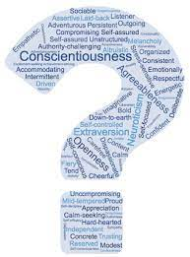
TEST OF PERSONALITY
There are 2 types of test :
Projective techniques
Non projective techniques
By Ms. Saroj Bala
(Faculty, RUHS CONS)

Slide 27
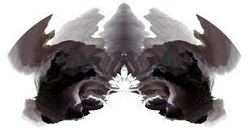
1. Projective techniques
TAT (Thematic apperception test)
CAT (Children association test)
WAT (Word association test)
SCT (Sentence completion test)
Rorschach Inkblot test
PF Study (Picture frustration test)
By Ms. Saroj Bala
(Faculty, RUHS CONS)

Slide 28
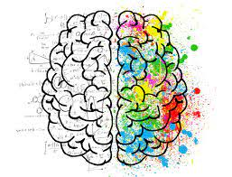
2. Non projective techniques
These are divided into 3 types:
Subjective method
Objective methods
Psychoanalytical method
By Ms. Saroj Bala
(Faculty, RUHS CONS)

Slide 29

1. Subjective method
Autobiography
Case study
Interview
Questionnaires
Inventories
By Ms. Saroj Bala
(Faculty, RUHS CONS)

Slide 30

2. Objective Methods
Performance Test
Rating Scale Test
Sociometric Test
Observation Test
Situational Tests
By Ms. Saroj Bala
(Faculty, RUHS CONS)

Slide 31

3. Psychoanalytical test
Free association test
Dream analysis test
Hypnotic techniques
By Ms. Saroj Bala
(Faculty, RUHS CONS)

Slide 32
Thank You
Ms. Saroj Bala (Faculty, RUHS CONS)
Digital Assistance By:
Arsha Nair (Student, BSc Nursing Part II, RUHS CONS)
Lovely Sharma (Student, BSc Nursing Part I, RUHS CONS)

